Slide 1

NeoFund Total Portfolio Insights Using Graph
Samko Yun & Ben Lumley
NeoFund
Notes:
Thanks for the opportunity to present the solution Neo4j has to developed for NeoFund.
A sovereign wealth fund with a $295b investment portfolio.
Together with my colleague Samko, who will run us through the demo, I will provide a brief overview of the solution and why its important for you.

Slide 2






The Challenges for NeoFund Investment Analysts
Focus is ensuring ethical portfolio investments along with financial performance.
NeoFund currently exclude assets related to:
But, there are many other ethical/ESG considerations:
Human Rights & Slavery
International
Sanctions
Climate
And….
Tobacco Products
Controversial weapons
Notes:
Your focus is supporting the Management Board by ensuring ethical portfolio investments, alongside financial performance considerations.
The only current excluded assets relate to:
Primary manufacture of complete tobacco products.
Controversial weapons-related Conventions or Treaties
But, there are many other ethical/ESG factors to consider. Such as:
human rights & slavery
fossil fuels
international sanctions

Slide 3





Complexities for Investment Analysts
Complex Corporate
Hierarchies
Political Pressure
Geo-political Instability
Media Scrutiny
Citizen
Expectations
Notes:
Add to this:
complex corporate hierarchies
geo-political instability
political pressure
media scrutiny
citizen expectations

Slide 4

Notes:
Why graph was the best solution for Neofund was due to the large volume of both structured and unstructured data.
This is a common situation we see globally.

Slide 5
Total Portfolio Insights Solution for NeoFund
Investment Analyst’s
Workday
Pain Points
Impact
Identifying relevant unstructured information
15%
Large Volume of Unstructured documents limiting insight discovery
Complex Corporate Hierarchies
Limited Visualisation of portfolio risks
Impacts >$2.3M of effort through inefficient processes
*Based on the $122k average salary of an investment analyst for a team of 30.
Unmitigated reputational and financial
Opportunity costs of not investing in appropriate assets
Analyse & synthesize
15%
Interpret insights
15%
Identify & assess risk
10%
Innovate
10%
Communicate
20%
How can we synthesise and connect large volume of information during investment decision?
Meetings
15%
We need better compliance assurance to avoid reputational risks
Notes:
65% of their typical workday
Synthesise and connect large volumes of information to support decisions
Being able to provide better assurance to avoid risks
Graph based insights solution we called Total Portfolio Insights

Slide 6
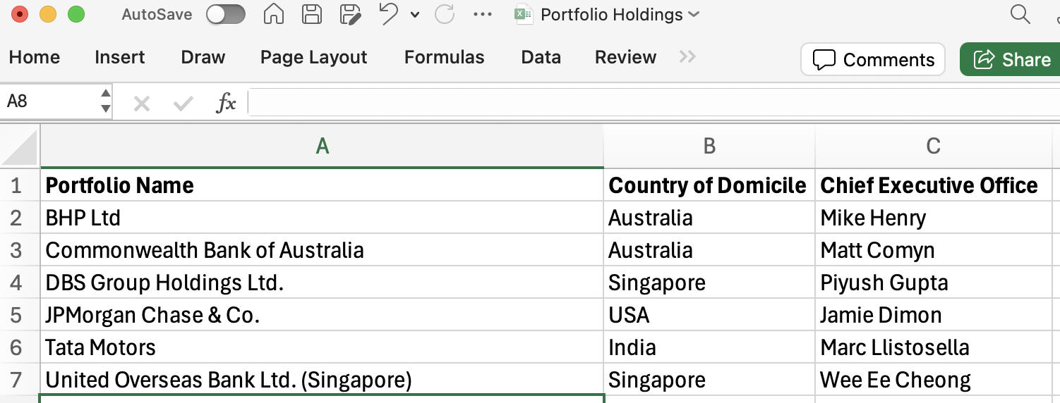
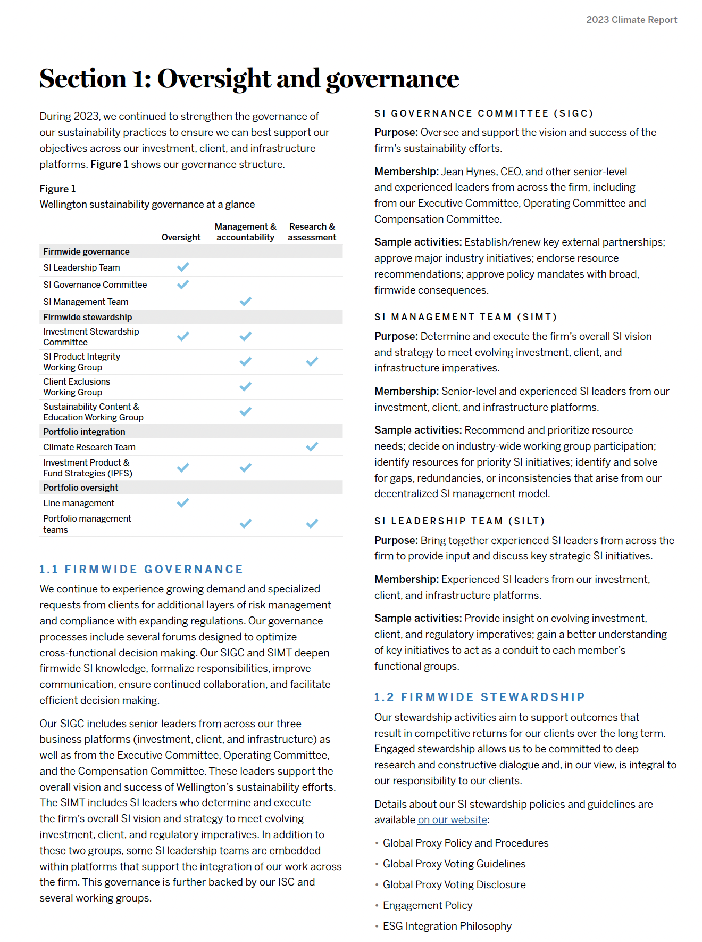
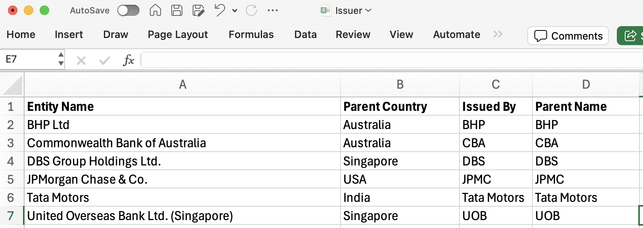
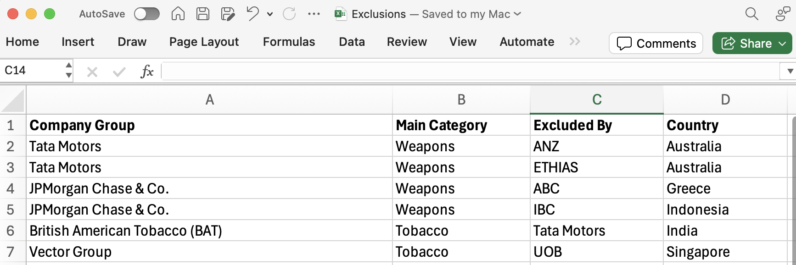
NeoFund has untapped disparate data sources
Structured Data
Unstructured Data
May 2024 | John Smith
TESLA
Competes with
TATA MOTORS
Notes:
Investment analyst are required to consume and interpret disparate structured and unstructured data sources to inform investment decisions.
With Graph we are able to put the needed insights at the finger tip of investment analysts while providing additional insights and capabilities

Slide 7
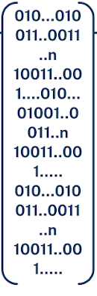
Graph helps NeoFund generate richer insights
Structured
Data
Unstructured
Data
Entity and Relationship
Metadata
Tesla
CONTAINS_ENTITY
2023 Climate Report
HAS_AUTHOR
John Smith
ULTIMATE_PARENT
COMPETES_WITH
HAS_SECTION
CONTAINS_ENTITY
HAS_PUBLISHED_DATE
Tata Motors
Tata Motors
Tata Motors
Section 1
May 2024
Tata Motors
IS_SIMILAR_TO
IS_MOST_SIMILAR_TO
CONTAINS_ENTITY
COUNTRY_OF_DOMICILE
HAS_PARENT_COUNTRY
Semantic Search
HAS_CHUNK
HAS_CHUNK
EXCLUDES_ENTITY
EXCLUDES_ENTITY
ANZ
ETHIAS
India
This is the start of section 1
This is the next part of section 1
India
HAS_NEXT_CHUNK
HAS_EMBEDDINGS
HAS_EMBEDDINGS
Text Embedding
Text Embedding

Slide 8
Total Portfolio Insights - Demonstration

